Slide 1
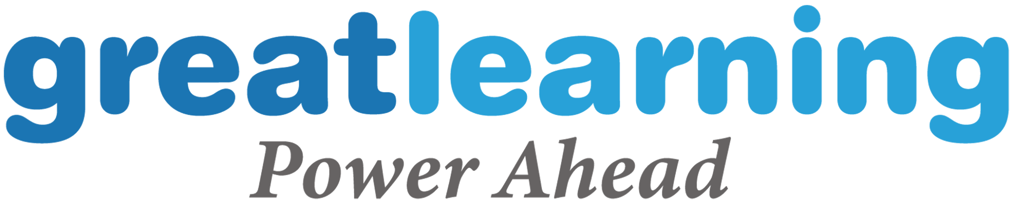
Multivariate Time Series
Time Series Forecasting

Slide 2
Proprietary content. © Great Learning. All Rights Reserved. Unauthorized use or distribution
Agenda
Business Problem
Approaches to Statistical Analysis in a Time Series
General Applications of VAR Model.
Forecasting VAR Model.
Forecasting VARMA Model.

Slide 3
Proprietary content. © Great Learning. All Rights Reserved. Unauthorized use or distribution
Business problem: A chain of stores which was been established and driving their operations across in the city of mexico, keen to predict the footfall of few specific stores of them.
It is important for a stores to know there sales which was been influenced by multiple factors in which footfall was one of the major factor.
This model forecast can be used to predict the footfall of the customers for an specific stores on which the management was keen to know there future footfall the stores was been labelled with an unique code ‘’1044”,”1041”.

Slide 4
Proprietary content. © Great Learning. All Rights Reserved. Unauthorized use or distribution
Dependent Variable
The variable we wish to explain or predict
Usually denoted by Y
Dependent Variable = Response Variable = Target Variable
Here ‘Customers’ is our target variable

Slide 5
Proprietary content. © Great Learning. All Rights Reserved. Unauthorized use or distribution
Independent Variable
The variables used to explain the dependent variable
Usually denoted by X
Independent Variable = Predictor Variable
In our example, store,day of week, open, promotion, state holiday, school holiday are the independent variables,date

Slide 6
Proprietary content. © Great Learning. All Rights Reserved. Unauthorized use or distribution
Visiting Basics

Slide 7
Proprietary content. © Great Learning. All Rights Reserved. Unauthorized use or distribution
Variable that contributes to Carbon Dioxide (in parts per million)
Store,
Day of Week, Open, Promotion,
State Holiday,
School Holiday,
Date (Independent Variable)
Customers
(Target Variable)

Slide 8
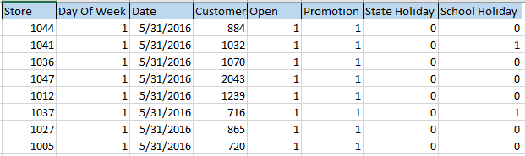
Proprietary content. © Great Learning. All Rights Reserved. Unauthorized use or distribution
Data
Let us consider the following data.

Slide 9
Proprietary content. © Great Learning. All Rights Reserved. Unauthorized use or distribution
Approaches to Statistical Analysis in a Time Series
Univariate Time-Series Analysis
Multivariate Time-Series Analysis

Slide 10
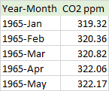
Proprietary content. © Great Learning. All Rights Reserved. Unauthorized use or distribution
Approaches to Statistical Analysis in a Time Series
Univariate Time Series :-
The data which consists of single time-dependent variable.
Example : Find the reference dataset that consists of the CO2 emissions (every month), for the previous few months. Here, CO2 is an dependent variable (dependent on Time/month).

Slide 11
Proprietary content. © Great Learning. All Rights Reserved. Unauthorized use or distribution
Approaches to Statistical Analysis in a Time Series
Multivariate Time Series :-
The data which consists of more than one time-dependent feature ,Every individual features relay not on its previous/past values/data but exisiting of dependency with neighbour variables,This dependency helps the model to forecast the future values/data points.

Slide 12
Proprietary content. © Great Learning. All Rights Reserved. Unauthorized use or distribution
Approaches to Statistical Analysis in a Time Series
Multivariate Time Series :-
Example : Find the reference dataset that consists of the Room Occupancy along with temperature,humidity,light,CO2,humidity ratio of every minute for one week of data in a month. Here, there are multiple features to be considered to predict an optimal temperature . This series would come under multivariate time series category.
1 2 3 4 5 6 7 | "date","Temperature","Humidity","Light","CO2","Humidity_Ratio","Occupancy" "1","2015-02-04 17:51:00",23.18,27.272,426,721.25,0.00479298817650529,1 "2","2015-02-04 17:51:59",23.15,27.2675,429.5,714,0.00478344094931065,1 "3","2015-02-04 17:53:00",23.15,27.245,426,713.5,0.00477946352442199,1 "4","2015-02-04 17:54:00",23.15,27.2,426,708.25,0.00477150882608175,1 "5","2015-02-04 17:55:00",23.1,27.2,426,704.5,0.00475699293331518,1 "6","2015-02-04 17:55:59",23.1,27.2,419,701,0.00475699293331518,1

Slide 13
Proprietary content. © Great Learning. All Rights Reserved. Unauthorized use or distribution
Vector Time Series Models
Is one of the most common method used to deal with Multivariate Time-Series data.
This is a stochastic process model utilized to seize the linear relation among the multiple variables of time-series data.
In other words, it is a multivariate forecasting method utilized when two or more time-series variables have a strong internal relationship with each other.
VAR is a bidirectional model, while others are unidirectional models.
In a unidirectional model, a predictor influences the target, but not vice versa. In a bidirectional model, variables influence each other.

Slide 14
Proprietary content. © Great Learning. All Rights Reserved. Unauthorized use or distribution
Why do we need VAR?
Time-series data with autoregressive in nature (serially correlated)
VAR model is one of the most successful and flexible models for the analysis of multivariate time series
Especially useful for describing the dynamic behavior of economic and financial time series
Useful for forecasting

Slide 15
Proprietary content. © Great Learning. All Rights Reserved. Unauthorized use or distribution
General Applications of VAR
In economics, VAR is used to forecast macroeconomic variables, such as GDP, money supply, and unemployment
In finance, predict spot prices and future prices of securities; foreign exchange rates across markets
Analysis of system response to different shocks/impacts
Model-based forecast. In general VAR encompasses correlation information of the observed data and use this correlation information to forecast future movements or changes of the variable of interest

Slide 16
Proprietary content. © Great Learning. All Rights Reserved. Unauthorized use or distribution
General Applications of VAR
In accounting, predict different accounting variables such as sales, earnings, and accruals
In marketing, VAR can be used to evaluate the impact of different factors on consumer behavior and forecast its future change.

Slide 17
Proprietary content. © Great Learning. All Rights Reserved. Unauthorized use or distribution
Vector Time Series Models
A stationary vector time series process Z_{t} that is purely non-deterministic can always be written as a moving average representation, and an invertible vector time series process can always be written as an autoregressive representation.
This involve an infinite number of coefficient matrices in the representation. In practice, with a finite number of observations, we will construct a time series model with a finite number of coefficient matrices. Specifically, we will present VAR(p), VARMA(p, q).

Slide 18
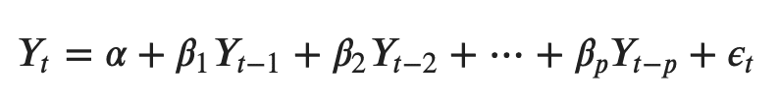
Proprietary content. © Great Learning. All Rights Reserved. Unauthorized use or distribution
Vector Autoregression - ( VAR )
The normal AR(p) model equation looks like this:
where α is the intercept, a constant and β1, β2 till βp are the coefficients of the lags of Y till order p.
Order ‘p’ means, up to p-lags of Y is used and they are the predictors in the equation. The ε_{t} is the error, which is considered as white noise.

Slide 19
Proprietary content. © Great Learning. All Rights Reserved. Unauthorized use or distribution
Vector Autoregression - ( VAR )
VAR model, each variable is modeled as a linear combination of past values of itself and the past values of other variables in the system. Since you have multiple time series that influence each other, it is modeled as a system of equations with one equation per variable (time series).
That is, if you have 5 time series that influence each other, we will have a system of 5 equations.

Slide 20
Proprietary content. © Great Learning. All Rights Reserved. Unauthorized use or distribution
Vector Autoregression - ( VAR )
In General, how an equation is been exactly framed:
Let’s suppose, you have two variables (Time series) Y1 and Y2, and you need to forecast the values of these variables at time (t).
To calculate Y1(t), VAR will use the past values of both Y1 as well as Y2. Likewise, to compute Y2(t), the past values of both Y1 and Y2 be used.

Slide 21
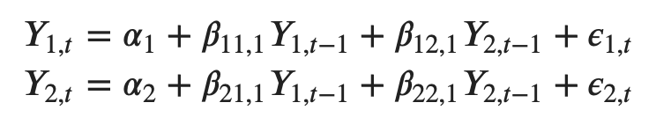
Proprietary content. © Great Learning. All Rights Reserved. Unauthorized use or distribution
Vector Autoregression - ( VAR )
For example, the system of equations for a VAR(1) model with two time series (variables `Y1` and `Y2`) is as follows:
Where, Y{1,t-1} and Y{2,t-1} are the first lag of time series Y1 and Y2 respectively.
The above equation is referred to as a VAR(1) model, because, each equation is of order 1, that is, it contains up to one lag of each of the predictors (Y1 and Y2).

Slide 22
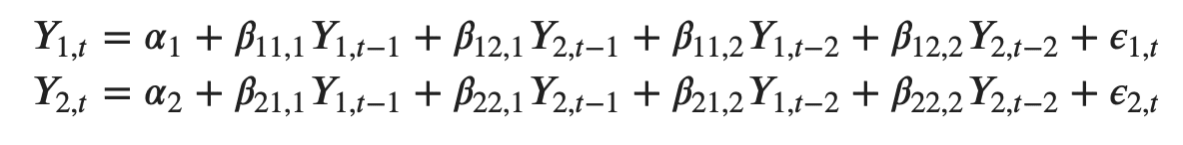
Proprietary content. © Great Learning. All Rights Reserved. Unauthorized use or distribution
Vector Autoregression - ( VAR )
Since the Y terms in the equations are interrelated, the Y’s are considered as endogenous variables, rather than as exogenous predictors.
Likewise, the second order VAR(2) model for two variables would include up to two lags for each variable (Y1 and Y2).

Slide 23
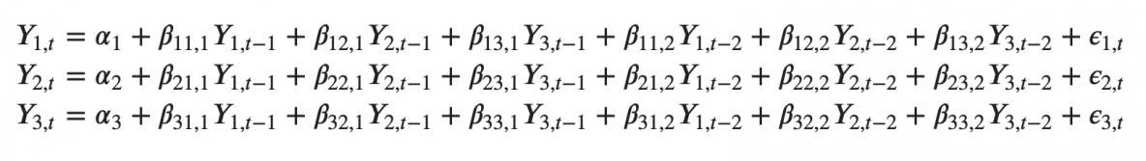
Proprietary content. © Great Learning. All Rights Reserved. Unauthorized use or distribution
Vector Autoregression - ( VAR )
For an example how an second order VAR(2) model with three variables (Y1, Y2 and Y3) would be framed.
As you increase the number of time series (variables) in the model the system of equations become larger.

Slide 24

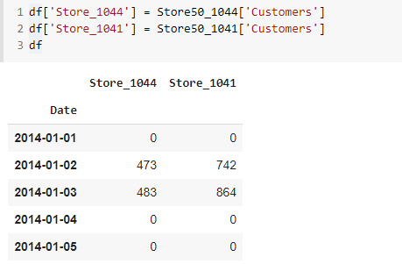
Proprietary content. © Great Learning. All Rights Reserved. Unauthorized use or distribution
Vector Autoregression - ( VAR )
As per the business requirement we are segregating the two specific stores from dataframe to perform analysis.

Slide 25
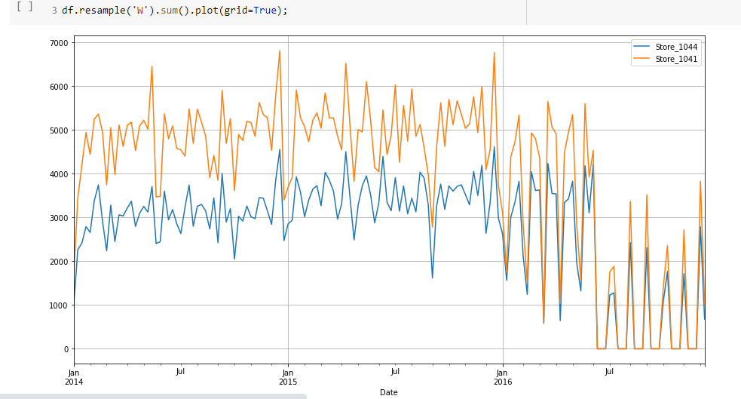
Proprietary content. © Great Learning. All Rights Reserved. Unauthorized use or distribution
Vector Autoregression - ( VAR )
Currently, our data was split day-wise,for an better visualisation, interpreting the inference of data we have been re-sampled to week-wise how do the customers footfall weekly .
We can observe the footfall of customers are
Higher in store_1041 than store_1044.
We can infer ,the data was stationary.

Slide 26
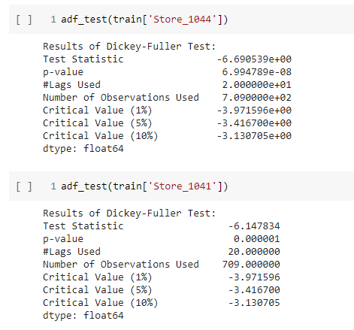
Proprietary content. © Great Learning. All Rights Reserved. Unauthorized use or distribution
Vector Autoregression - ( VAR )
Let’s perform Dickey-Fuller test to evaluate the stationarity of data.
We can infer from the code output that the series
Of data is stationary.
Hence,no need of differentiation.

Slide 27
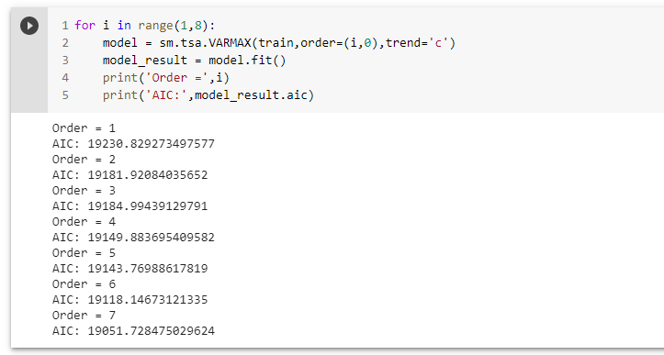
Proprietary content. © Great Learning. All Rights Reserved. Unauthorized use or distribution
Best parameters are selected in accordance with the lowest Akaike Information Criteria (AIC)
We can interpret as we are running this iteration upto 7 days since this is a day-wise data and we have seen that the customer footfall has a seasonality of 7.

Slide 28
Proprietary content. © Great Learning. All Rights Reserved. Unauthorized use or distribution
Model Evaluation

Slide 29
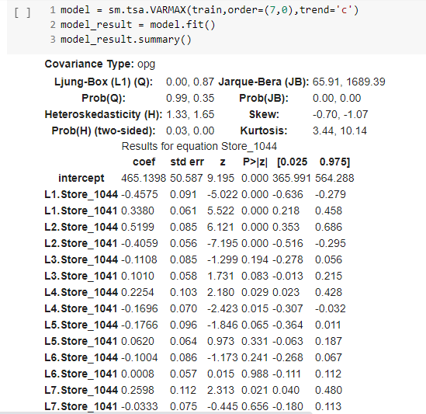
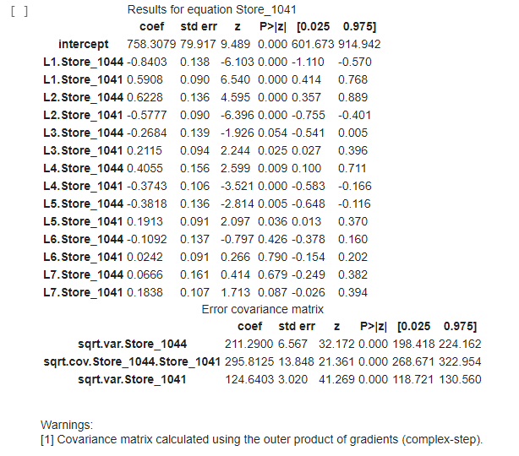
Proprietary content. © Great Learning. All Rights Reserved. Unauthorized use or distribution
Model Evaluation

Slide 30
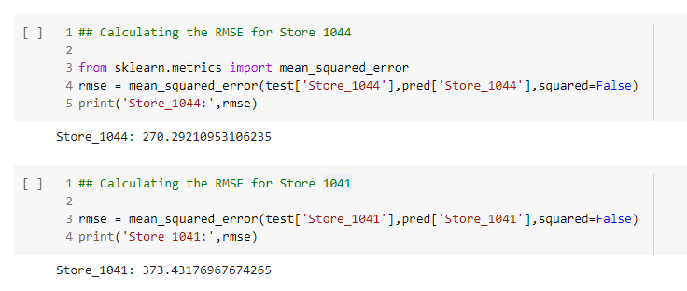
Proprietary content. © Great Learning. All Rights Reserved. Unauthorized use or distribution
Model Evaluation
Hence, our series of data is stationary we are able to secure the optimal RMSE.
We can still tune the model for much better evaluation metric scores.

Slide 31
Proprietary content. © Great Learning. All Rights Reserved. Unauthorized use or distribution
Summary
Vector Autoregression (VAR) model is an extension of univariate autoregression model to multivariate time series data.
VAR model is a multi-equation system where all the variables are treated as endogenous (dependent)
There is one equation for each variable as dependent variable. In its reduced form, the right-hand side of each equation includes lagged values of all dependent variables in the system, no contemporaneous variables.
The method is suitable for multivariate time series without trend and seasonal components.

Slide 32
Proprietary content. © Great Learning. All Rights Reserved. Unauthorized use or distribution
VARMA

Slide 33
Proprietary content. © Great Learning. All Rights Reserved. Unauthorized use or distribution
Business problem: The wall street journal want to publish an article on
Stock predictions after the presidential elections held in US for the year 2016, how it impacts the stock indices.
S&P Index is stock market index that measures the stock performance of 30 large companies listed on stock exchanges in the United States. Although it is one of the most commonly followed equity indices.
This model forecast can be used to predict the stock price indexes by considering the past one year data of 2016 and predict one month of stock price index for the year 2017.

Slide 34
Proprietary content. © Great Learning. All Rights Reserved. Unauthorized use or distribution
Visiting Basics

Slide 35
Proprietary content. © Great Learning. All Rights Reserved. Unauthorized use or distribution
Vector Autoregression Moving Average - (VARMA)
The Vector Autoregression Moving-Average (VARMA) method models the next step in each time series using an ARMA model. It is the generalization of ARMA to multiple parallel time series, e.g. multivariate time series.
The notation for the model involves specifying the order for the AR(p) and MA(q) models as parameters to a VARMA function, e.g. VARMA(p, q). A VARMA model can also be used to develop VAR or VMA models.
The method is suitable for multivariate time series without trend and seasonal components.

Slide 36
Proprietary content. © Great Learning. All Rights Reserved. Unauthorized use or distribution
Vector Autoregression Moving Average - (VARMA)
The VARMA model is another extension of the ARMA model for a multivariate time-series model that contains a vector autoregressive (VAR) component, as well as the vector moving average (VMA).
VARMA is an inductive version of ARMA for multiple parallel time series. The ARMA notation for the model comprises the individually ordered AR(p), and the MA(q) models are the parameters to a VARMA model.
For instance, VARMA(p, q) is an example. A VARMA model will be able to develop VAR or VMA models.

Slide 37

Proprietary content. © Great Learning. All Rights Reserved. Unauthorized use or distribution
Vector Autoregression Moving Average - (VARMA)
Here are the VAR (1) and VMA(1) models with two time-series datasets (Y1 and Y2):
where y1,t-1, y2,t-1 are the first lag of time series Y1 and Y2.
The VARMA model follows the same rules for the design model similar to the univariate time series. It is utilizing the corresponding evaluation matrices such as AIC, BIC, FPE, and HQIC.

Slide 38
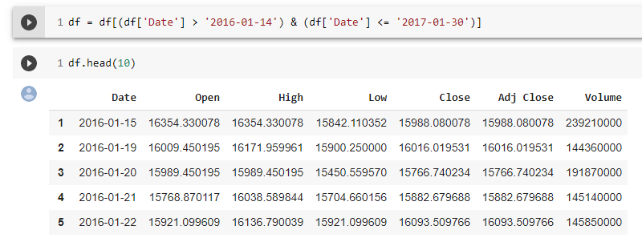
Proprietary content. © Great Learning. All Rights Reserved. Unauthorized use or distribution
Vector Autoregression Moving Average - (VARMA)
As per the business requirement we are segregating and considering the respective records to build a model and forecast accordingly.

Slide 39
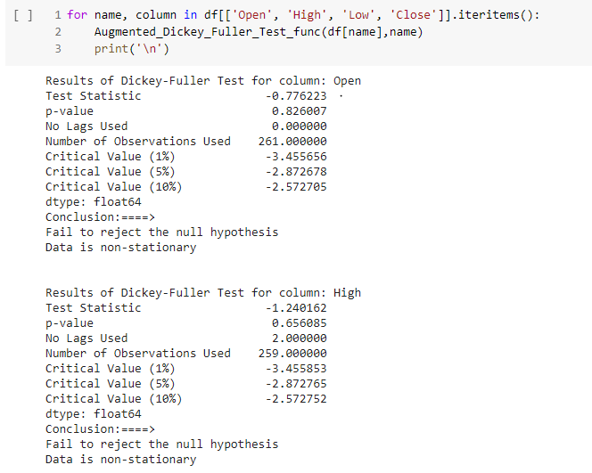
Proprietary content. © Great Learning. All Rights Reserved. Unauthorized use or distribution
Vector Autoregression Moving Average - (VARMA)
Checking for stationarity of data
We can infer from the given output that
the attributes : ‘Open’,‘High’ are
Non- stationary.

Slide 40
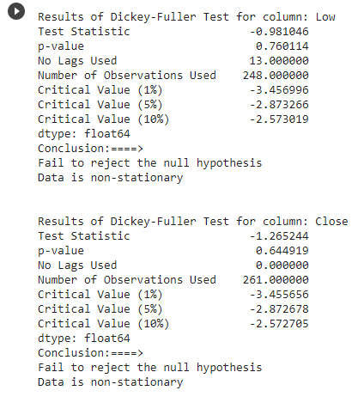
Proprietary content. © Great Learning. All Rights Reserved. Unauthorized use or distribution
Vector Autoregression Moving Average - (VARMA)
Checking for stationarity of data
We can infer from the given output that
the attributes : ‘Low’,‘Close’ are
Non- stationary.

Slide 41

Proprietary content. © Great Learning. All Rights Reserved. Unauthorized use or distribution
Vector Autoregression Moving Average - (VARMA)
Splitting the data into train and test.
We would be considering the train data that consists of all the data except the last 30 days, and the test data which consists of only the last 30 days to evaluate on future forecasting.

Slide 42

Proprietary content. © Great Learning. All Rights Reserved. Unauthorized use or distribution
Vector Autoregression Moving Average - (VARMA)
We are performing differencing on data by using pandas to stationarize.

Slide 43
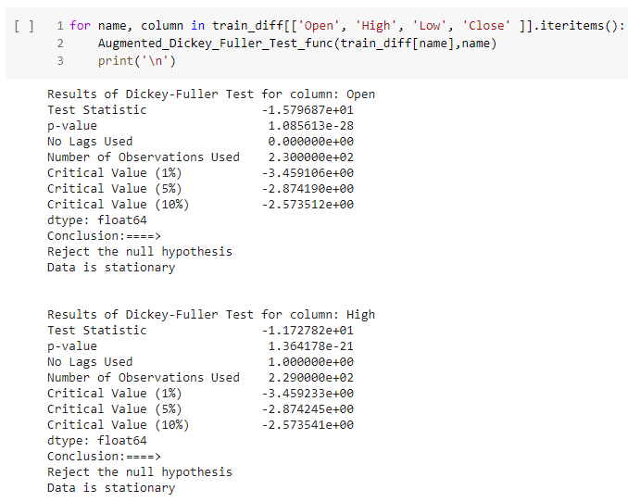
Proprietary content. © Great Learning. All Rights Reserved. Unauthorized use or distribution
Vector Autoregression Moving Average - (VARMA)
Checking for stationarity of data after the
First differencing.
We can infer from the given output that
the attributes : ‘Open’,‘High’ are
Stationarised now.

Slide 44
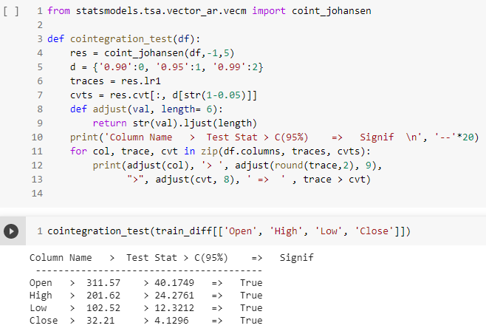
Proprietary content. © Great Learning. All Rights Reserved. Unauthorized use or distribution
Vector Autoregression Moving Average - (VARMA)
Cointegration is used to check for the
Existence of a long-run relationship
between two or more variables.
However, the correlation does not
necessarily mean “long run.”
We can infer from output that there is the
presence of a long-run relationship
between features,hence because the
Significance is ‘True’.

Slide 45
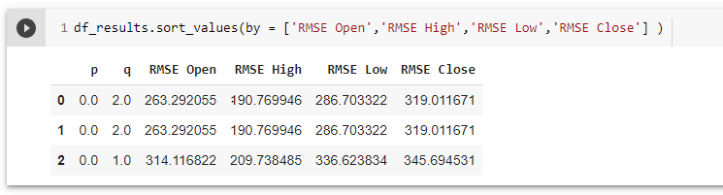
Proprietary content. © Great Learning. All Rights Reserved. Unauthorized use or distribution
Vector Autoregression Moving Average - (VARMA)
We are performed the analysis to obtain an optimal ‘p’,’q’ which possess an minimal RMSE .
We can infer from the output that order(‘p’,’q’)(0,2) has an optimal/least RMSE.

Slide 46
Proprietary content. © Great Learning. All Rights Reserved. Unauthorized use or distribution
Model Evaluation

Slide 47
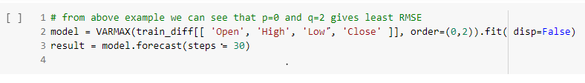
Proprietary content. © Great Learning. All Rights Reserved. Unauthorized use or distribution
Model Evaluation
We have fitted the time series data with VARMA model.
We can infer from the input code that we have considered the order(‘p’,’q’)(0,2) hence,because its providing an optimal/lease. RMSE

Slide 48
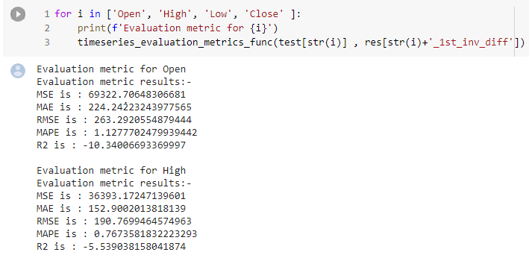
Proprietary content. © Great Learning. All Rights Reserved. Unauthorized use or distribution
Model Evaluation
Evaluate the results for every
Individual attribute .
We can find the various evaluation
Metric’s with score’s from the
Given output for the attributes
‘Open’,‘High’.

Slide 49
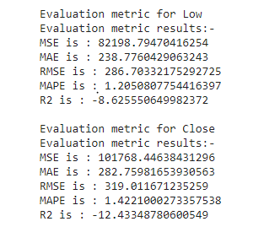
Proprietary content. © Great Learning. All Rights Reserved. Unauthorized use or distribution
Model Evaluation
Evaluate the results for every
Individual attribute .
We can find the various evaluation
Metric’s with score’s from the
Given output for the attributes ‘Low’,
‘Close’.

Slide 50
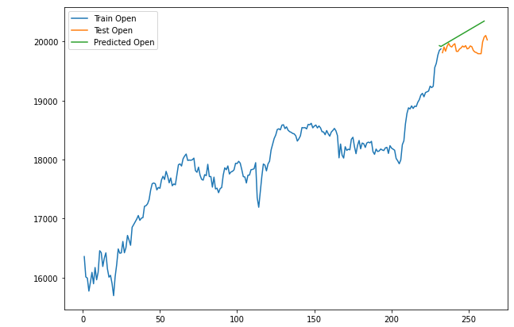
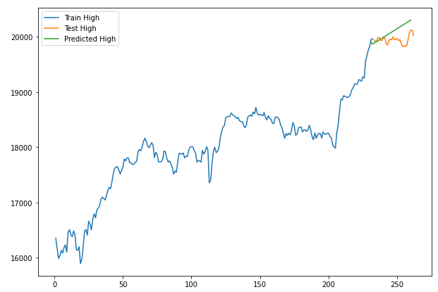
Proprietary content. © Great Learning. All Rights Reserved. Unauthorized use or distribution
Model Evaluation
We can infer the results for the attributes ‘Open’,’High’ from the below visualisation plot.

Slide 51
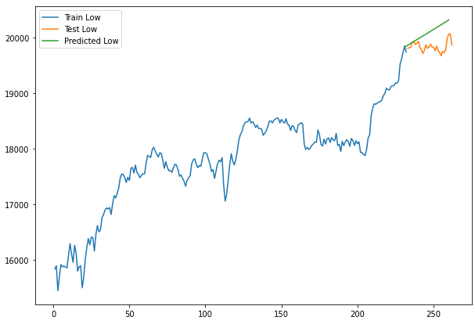
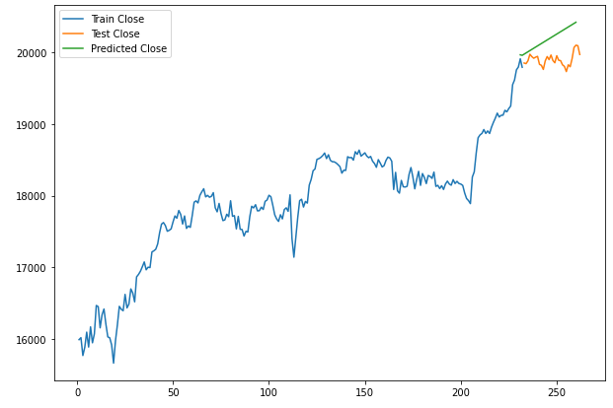
Proprietary content. © Great Learning. All Rights Reserved. Unauthorized use or distribution
Model Evaluation
We can infer the results for the attributes ‘Low’,’close’ from the below visualisation plot.

Slide 52
Proprietary content. © Great Learning. All Rights Reserved. Unauthorized use or distribution
Reference
Vector Autoregressive Models for Multivariate Time Series. http://faculty.washington.edu/ezivot/econ584/notes/varModels.pdf
Dwyer, Gerald P., Jr. Why Are Vector Autoregressions Useful in Finance? http://jerrydwyer.com/pdf/lectvar.pdf
Vector Autoregressions: Forecasting and Reality.http://www.frbatlanta.org/filelegacydocs/robtallman.pdf

